Slide 1
CONTAINER AS A SERVICE IN CLOUD: AN APPROACH TO SECURE HYBRID VIRTUALIZATION
D. Manoj (222010302045)
M. Sree Lakshmi (222010302029)
B. Akshitha (222010302050)
Y Devi Sri Priya (222010302012)
Under the supervision of
Prof. Manoj Kumar Patra
Department of Computer Science & Engineering
GITAM(Deemed to be University), Hyderabad
September 1, 2023

Slide 2
ABSTRACT
Containerization is one of the most recent advancements in cloud computing. Containers are a small package of
Software components That bundle an application, dependencies, and settings into a single image that may be
operated in isolated user environments on a physical machine or in a virtualized environment. Containers as a
service (CaaS) is a cloud service model that allows users to execute their tasks in an isolated environment. In
CaaS, containers are deployed in a virtual machine (VM), and in turn, virtual machines are deployed in a physical
machine (PM). Containers virtualize software, i.e., operating system (OS), and the virtual machine is the
mechanism of hardware virtualization. Hence, CaaS is also termed hybrid virtualization. This chapter discusses
different virtualization techniques in the cloud, the difference between hardware and software virtualization, what
containers are and why to use containers, and the architectural difference between virtual machine and container.
We discuss the CaaS cloud model, the architecture and implementation of CaaS, and the advantage and
disadvantages of CaaS. Then a detailed discussion on the research challenges available with the CaaS model is
presented. Finally, the chapter is concluded with a few future directions.

Slide 3
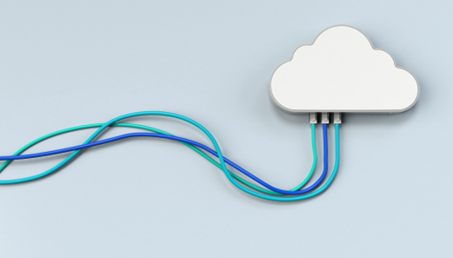
WHAT IS CLOUD COMPUTING?
Cloud Computing is the delivery of computing services – including servers, storage, databases, networking, software, analytics, and intelligence – over the Internet(‘the cloud’) to offer faster innovation, flexible resources, and economics of scale.
It is one of the emerging technology in the field of distributed computing and is designed as per the requirement and demand of the user.
Features:
Virtualization
On-demand availability
Low-cost services
Parallel computing
Security

Slide 4
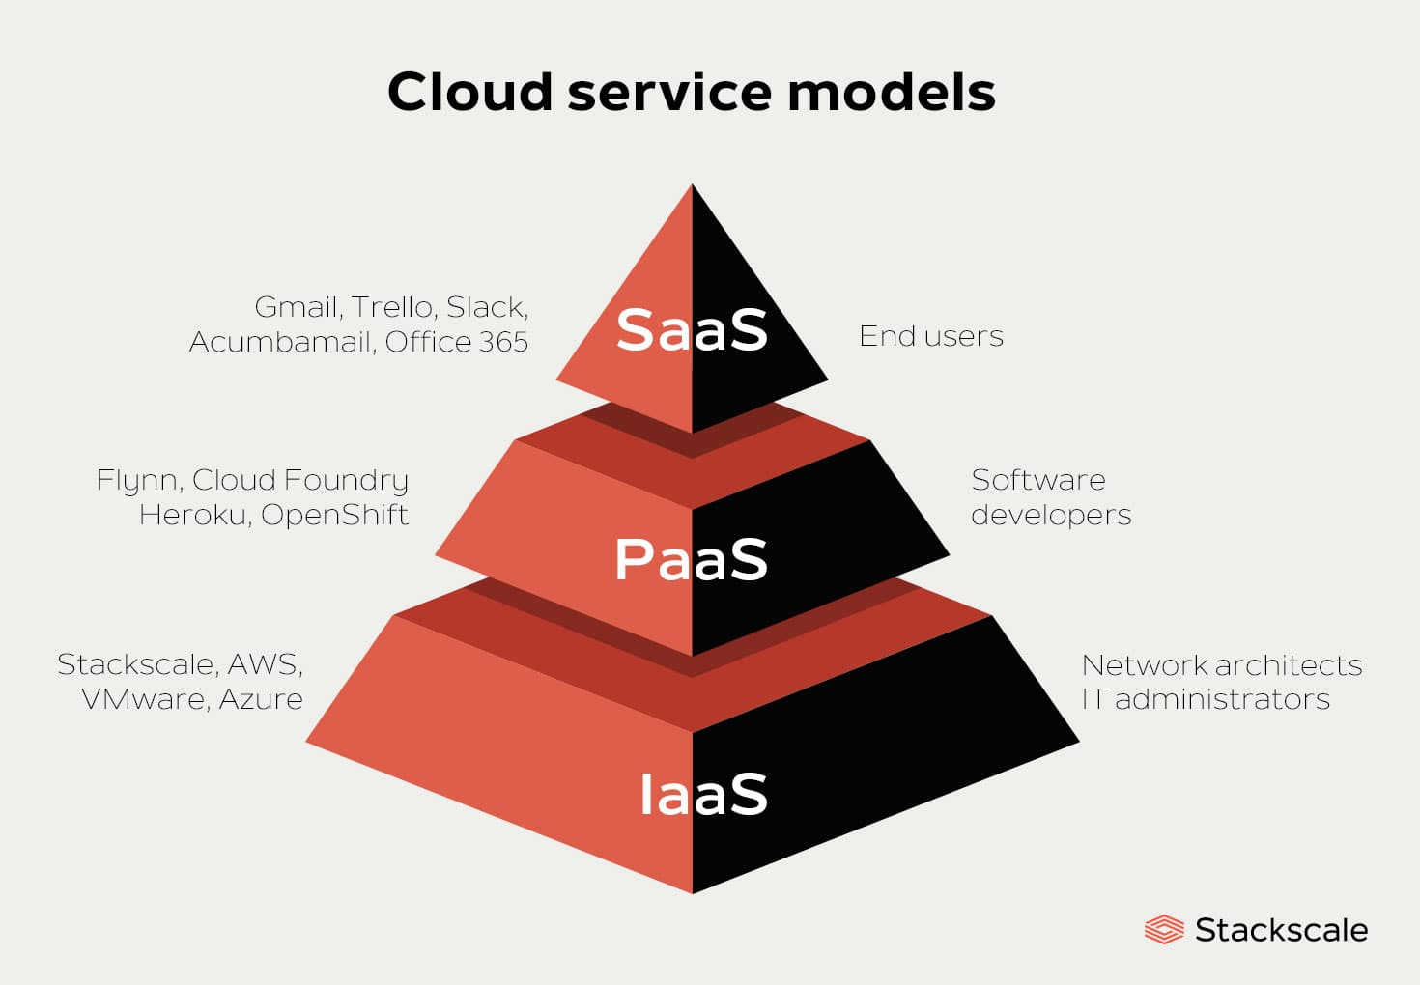
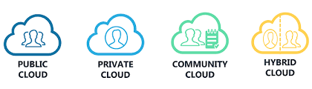
CLOUD DEPLOYMENT MODEL CLOUD SERVICE MODEL

Slide 5
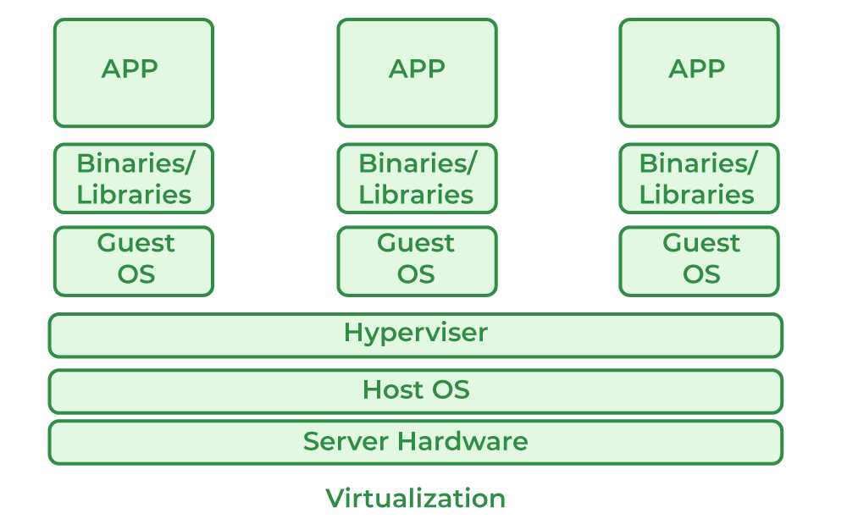
VIRTUALIZATION IN CLOUD COMPUTING
What is Virtualization?
Virtualization is the process of creating a software-based, or virtual representation of something, such as virtual applications, servers, storage and networks. Virtual machines(VMs) have been the backbone at the infrastructure layer providing virtualized operating systems.

Slide 6
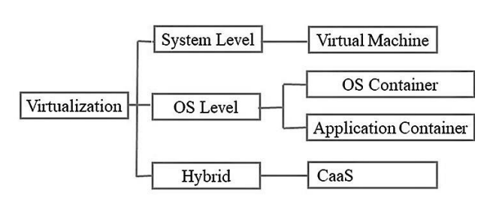
TYPES OF VIRTUALIZATION

Slide 7
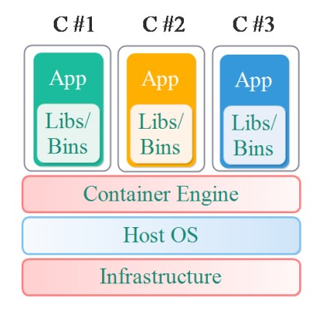
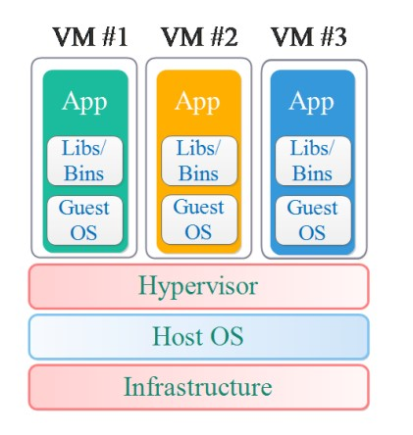
ARCHITECTURE OF CONTAINER VS VIRTUAL MACHINE
Container
Virtual Machine

Slide 8
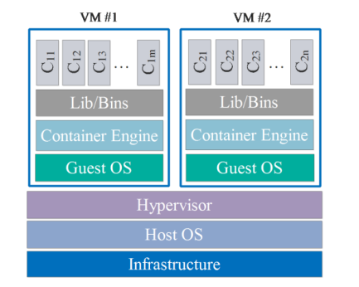
CONTAINER AS A SERVICE(CaaS)
What is CaaS?
CaaS (Container-as-a-Service) is a solution that automates them hosting and the deployment of containerized software packages. Containers emerged as a lightweight alternative to virtual machines (VMs) that offer better micro-service architecture support. With CaaS, software development teams can focus on their applications without the need to manage the underlying infrastructure. It eliminates the need for dedicated DevOps resources to oversee and manage the cloud machines and network routing systems that support containers.

Slide 9
Advantages and Disadvantages of CaaS
Advantages
Disadvantages
Portability
Scalability
Isolation
Consistency
Resource efficiency
Security
Complexity
Storage
Networking
Compatibility

Slide 10
Red Panda Optimization Algorithm in Container as a Service in Cloud:
- The Red Panda Optimization Algorithm (RPOA) is a nature-inspired optimization technique that draws inspiration from the behavior of red pandas in searching for food and mating partners.
- It's a population-based algorithm that simulates the foraging behavior of red pandas to find optimal solutions to various problems.
- RPOA's key components include population initialization, search space exploration, and optimization through iterative processes.
- It's characterized by exploratory and exploitative phases to strike a balance between local and global search.

Slide 11
Integration of RPOA in CaaS
- The integration of RPOA into CaaS environments aims to optimize resource allocation and container orchestration.
- RPOA can enhance CaaS by automating decisions related to container placement, scaling, and load balancing.
- Benefits include improved performance, cost reduction, and enhanced resource utilization.

Slide 12
Problem Formulation
- Problem formulation in the context of optimizing a Container as a Service (CaaS) environment involves defining specific objectives, constraints, and variables that the Red Panda Optimization Algorithm (RPOA) will work with.
- Objectives may include optimizing resource allocation, minimizing costs, or improving system performance.
- Constraints could involve limitations on resource availability, network bandwidth, or any other relevant factors.
- Variables represent the parameters that RPOA can adjust, such as the number of containers, their placement, or scaling decisions.

Slide 13
Implementing RPOA
- Implementing RPOA within a CaaS environment involves several steps:
Problem Formulation: Define the optimization problem, including objectives, constraints, and variables.
Fitness Function : Develop a fitness function that quantifies how well a particular solution performs with respect to the defined objectives.
Population Initialization: Create an initial population of potential solutions, often represented as configurations of containers.
Iteration: RPOA iteratively refines solutions by applying operators inspired by red panda foraging behaviors. This process involves both exploration (searching for better solutions) and exploitation (exploiting promising solutions).

Slide 14
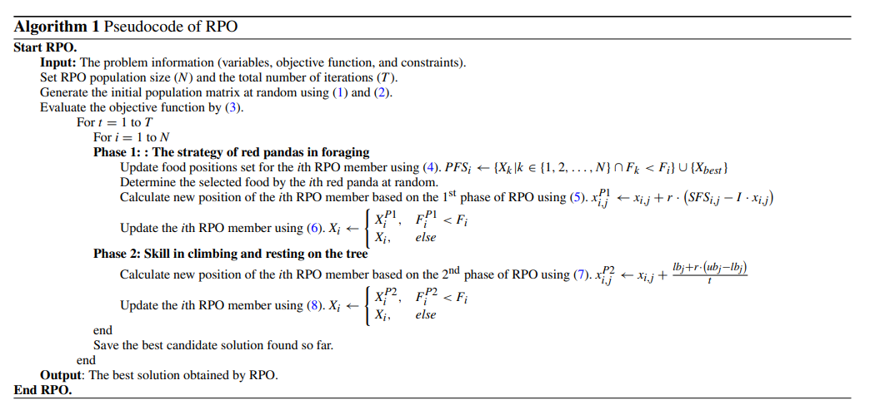

Slide 15
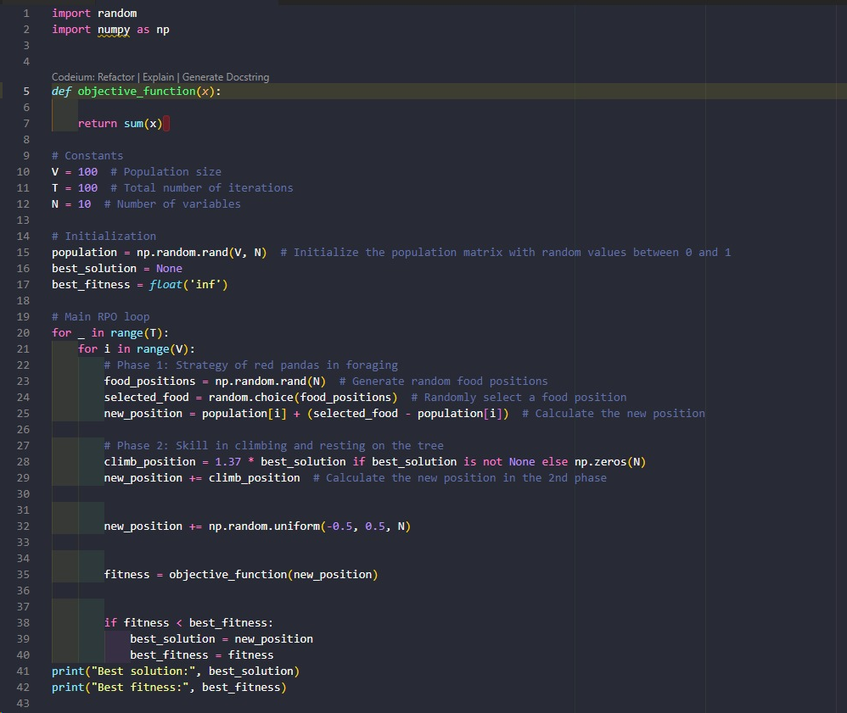


Slide 16
Case Studies
Load Balancing for E-commerce:
- Company: E-commerce Giant- Problem: An e-commerce giant needed to balance traffic across its containerized microservices to handle high user loads efficiently.
- Solution: RPOA was used to optimize the placement and scaling of containers, dynamically redistributing traffic.
- Outcomes: The load balancing improvements reduced response times by 20% during peak shopping seasons, leading to increased customer satisfaction and sales.

Slide 17
Future Directions:
- As technology and cloud computing continue to evolve, several future directions and trends are emerging in the integration of the Red Panda Optimization Algorithm (RPOA) with Container as a Service (CaaS) environments
Industry-Specific Applications- Expect to see industry-specific applications of RPOA in healthcare, finance, logistics, and more, addressing unique optimization challenges in various domains.
Community and Research Advancements- The research community will continue to refine RPOA, developing new variants and best practices for container optimization.- Collaboration and knowledge sharing will lead to further advancements.

Slide 18
THANK YOU!

